Slide 1
Chart Ferox, a.s. Děčín
Alternative Fuels for Ships

Slide 2
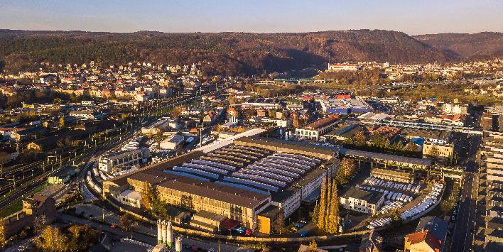
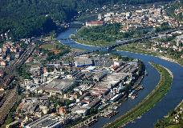
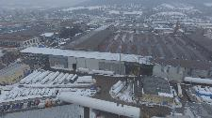

Chart Ferox – 75 years of manufacturing history
A premium leading European manufacturer of highly engineered equipment used in the production, storage and end-use of hydrocarbon and industrial gases.
History of Chart Ferox Facility – Děčín, Czech republic
1941 – 1945 Private company founded by Wilhelm Schmiding
2006 Ferox name changed to Chart Ferox, a.s.
2008 Chart Ferox, a.s. purchased Flow Instruments

Slide 3
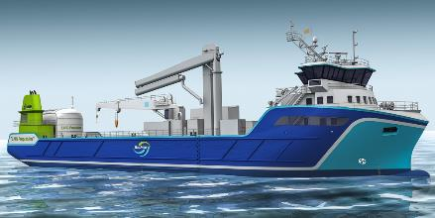
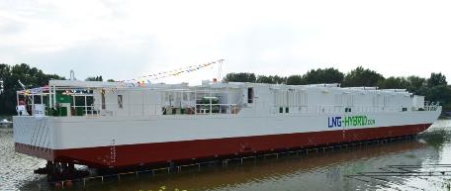
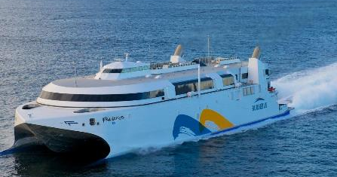
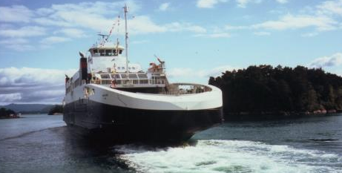
LNG Ship On-board Fueling – Alternative Fuels
Overseas and inland waterway systems
Fish feed carrier - Fuel tank 135 m3
LNG Power Barge in Hamburg
Fast Ferry – Francisco - 1000 passengers, 150 cars
LNG Ferry Fanafjord leaving Halhjem for Sandvikag
Storage tanks – 2x HT500

Slide 4
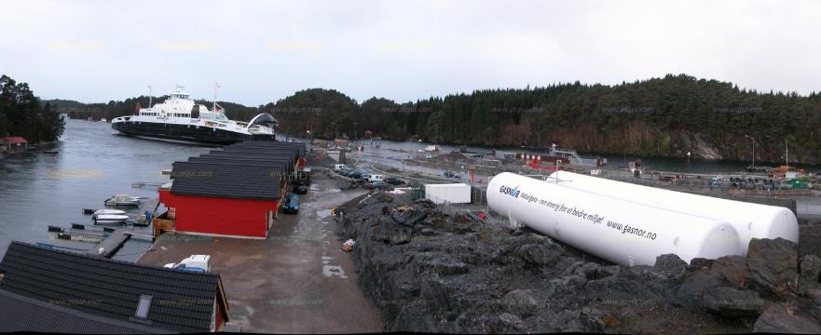
LNG Bunkering Terminals –
Alternative Fuels
Bunker all types of ships and ferries.
Ferry
VIP interconnecting piping
(bellow roadway)
Filling module
Storage tanks – 2x HT500
Storage tank: 2x HT 500 m3 (total 1000 m3 gross volume)
Cryogenic pump: 1700 liter/min
VIP: DN150; 100 meters (under the ground)
Refilling of the ships (e.g. BergensFjord – Norway – 2x 125 m3)
Frequency of filling of ships – every night !

Slide 5
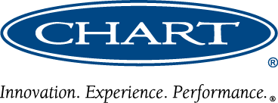




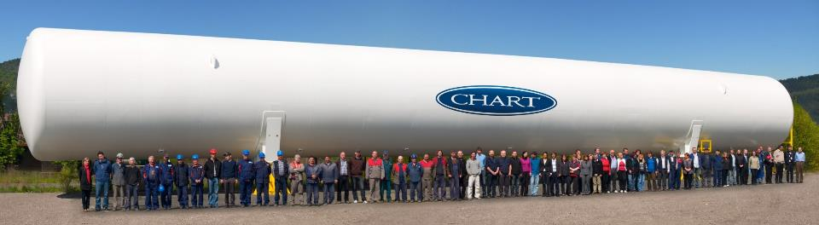
Thank You for Your Attention
www.chartindustries.com

